Slide 1

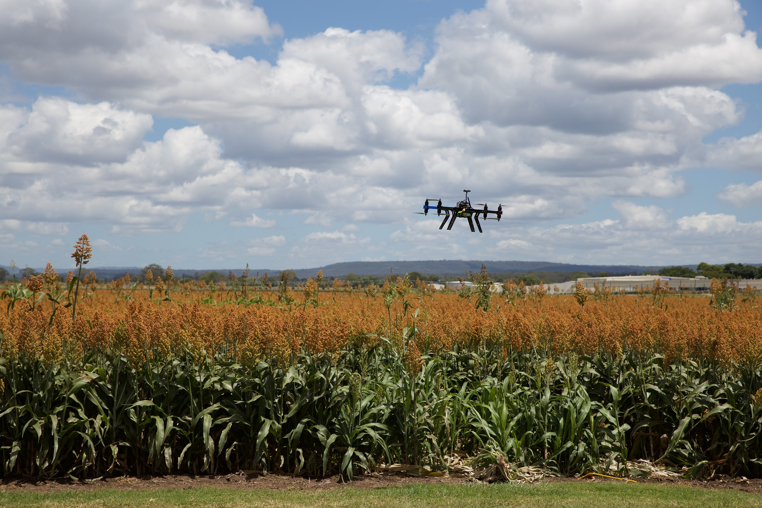

THE TRANSPORTATION AND LOGISTICS FORECAST BOOK 2018
DRONE, ROBOT, & AUTONOMOUS VEHICLE
FORECASTS
Jonathan Camhi
Senior Research Analyst
Ayoub Aouad
RESEARCH Analyst
PROVIDING IN-DEPTH INSIGHT, DATA, AND ANALYSIS OF EVERYTHING DIGITAL

Slide 2
56.8% CAGR
5.1% CAGR

Slide 3
US Connected And Autonomous Vehicle Shipments
Definition: Connected vehicles have internet access to transmit and gather data. Semi-autonomous vehicles have some level of autonomy but need a human driver behind the wheel, while fully autonomous cars don’t need a human driver and can drive in any conditions.
2023 AT A GLANCE
Nearly all new cars in the US will be connected by 2023, and 1 in 7 will have autonomous features.
There will be over 2.5 million semi- or fully autonomous cars on US roads.
HOW WE GET THERE
Connected car shipments will advance at a 5.1% CAGR from 2018 to 2023, while semi- and fully autonomous cars will deploy at a 56.8% growth rate.
Automakers and telecoms are connecting vehicles to gather data and offer consumers new services.
Connectivity will become a necessity as autonomous cars come onto US roads.
Source: Business Insider Intelligence estimates

Slide 4

16.9% CAGR
84.9% CAGR
Source: Business Insider Intelligence estimates

Slide 5
On-Demand Mobility Services' Share Of Miles Driven In US
Definition: On-demand mobility services are nonuser-owned forms of automobile transportation that can be accessed through a mobile app for timely travel. This includes ride-hailing, ride-sharing, and car-sharing services.
2030 AT A GLANCE
Autonomous cars used for on-demand mobility services will account for 16% of total miles driven in the US, compared with 13% for manually driven vehicles.
On-demand mobility services will account for 29% of miles driven in the US — autonomous cars will drive 640 billion miles, while manually driven cars will account for 520 billion miles.
HOW WE GET THERE
Autonomous services will begin to take off in 2025 as consumers become more trusting of the technology.
Cost savings will also be a selling point — on-demand rides in autonomous vehicles will cost around 25 cents per mile, less than half the cost of car ownership.
Waymo, Uber, Lyft, and several major automakers will expand their autonomous on-demand ride services across the country. In turn, manually driven miles will cap off at 13% of total miles driven in 2029.
Source: Business Insider Intelligence estimates

Slide 6
Note: The 2018 to 2023 CAGR is 59.8%.
Source: Business Insider Intelligence estimates

Slide 7
Annual US Volumes Of Data Generated By Connected, Semi- Autonomous, and Fully Autonomous Cars
Definition: Data generated includes any data that is being produced by a vehicle and its riders while the car is moving or stationary.
2023 AT A GLANCE
Total data generated in the US will approach 8 zettabytes (ZBs), up from 0.72 ZBs in 2018.
Semi-autonomous cars will make up nearly 80% of total data generated, or 6.3 ZBs.
HOW WE GET THERE
Data generated by connected, semi-autonomous, and fully autonomous cars is expected to grow at a 59.8% CAGR from 2018 to 2023.
Connected car shipments will help drive the amount of data being generated — 16.2 million cars will be shipped in 2023, compared with 12.6 million in 2018.
Semi-autonomous cars will drive data generation, producing 2,500 MBs per day, compared with only 25 MBs for connected cars.
Source: Business Insider Intelligence estimates

Slide 8
63.1% CAGR
69.4% CAGR

Slide 9
Global Enterprise Drone Shipments
Definition: Business Insider Intelligence defines enterprise drone shipments as all unmanned aerial vehicles (UAVs) sold directly to a business for use in its operations.
2023 AT A GLANCE
2.42 million enterprise drones will ship globally.
The US will account for 58% of enterprise drone shipments.
The majority of enterprise drones shipped elsewhere in the world will go to APAC markets, followed by Europe.
HOW WE GET THERE
Global enterprise shipments will grow at a 66.8% CAGR from 2018 to 2023. Growth will be led by the US, which will see a CAGR of 69.4% and account for the majority of shipments.
More exemptions to the Federal Aviation Administration's line-of-sight rule and ban on flying over humans will spur accelerated shipment growth in the US from 2019 onward.
A favorable regulatory environment and digital savvy consumer base will lead to APAC being the fastest-growing region.
Source: Business Insider Intelligence estimates

Slide 10
Note: The 2018 to 2023 CAGR is 45.1%.
Source: Business Insider Intelligence estimates, International Federation of Robotics

Slide 11
Global Logistics Robot Shipments
Definition: A logistics robot is a self-guided, self-propelled autonomous unit that moves goods in place of or in concert with a worker.
2023 AT A GLANCE
The installed base for logistics robots will grow quickly, rising from 100,000 in 2018 to over 600,000 in 2023.
This will be one of the fastest-growing segments of the robotics market, making up about 10% of total shipments.
HOW WE GET THERE
Global logistics robot shipments will grow at a 45.1% CAGR from 2018 to 2023.
Companies in logistics like Amazon, UPS, and Alibaba are automating their warehouses to reduce costs and cope with rising e-commerce volumes.
However, these systems will still only feature in fewer than 10% of global warehouses, leaving plenty of room for additional growth.
Source: Business Insider Intelligence estimates, International Federation of Robotics

Slide 13
Global Logistics Robot Spending
2023 AT A GLANCE
Spending on logistics robots will surpass $4.6 billion annually.
Logistics robots will account for about 16% of total robotics spending.
HOW WE GET THERE
Global logistics robot spending will grow at a 42.3% CAGR from 2018 to 2023.
Spending levels will be lower than in other robotics segments because of lower per-unit purchase costs, with the average system priced at about $26.5k.
Source: Business Insider Intelligence estimates, International Federation of Robotics

